Slide 1



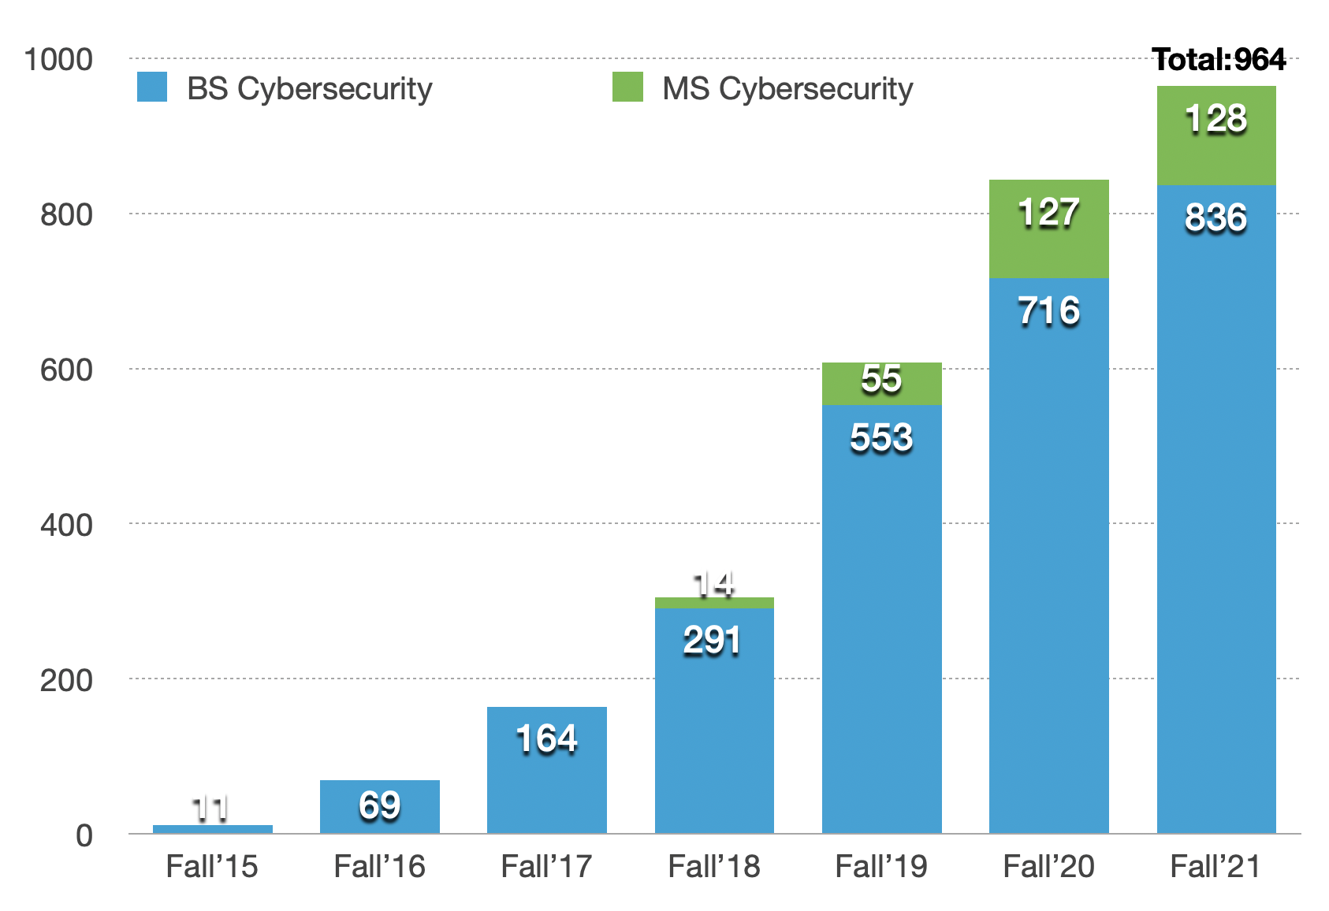
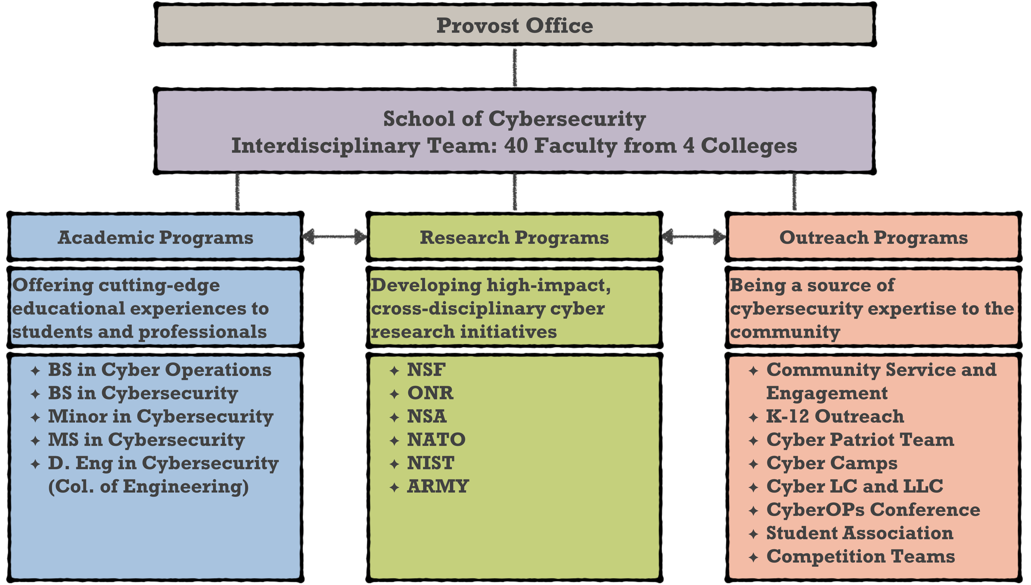
Developing Cyber Talents to Succeed through a Comprehensive Support Program
Old Dominion University, Norfolk, VA
History of Cybersecurity Program @ ODU
Understand the Need of Cybersecurity Education
Who are our supported students?
Center for Cybersecurity Education and Research created (2015)
Interdisciplinary major & minor in cybersecurity created in (2015)
Interdisciplinary major in cyber operations created (2017)
Cybersecurity programs placed online (2018)
MS in Cybersecurity created (2018)
Cyber Operations major received NSA CAE-CO designation (2019)
D.ENG in Cybersecurity created (2019)
Standalone BS in Cybersecurity created (2019)
School of Cybersecurity created (2020)
Increases the number of educated and skilled professionals in the cybersecurity industry, which are in strong demand;
Helps to balance the economic and social inequality of the nation by producing more students from low-income families entering the high-paying cybersecurity workforce;
Broaden the participation of underrepresented minority students in the much-needed STEM field, given that more than half of our cybersecurity students are from underrepresented minority groups.
Challenges in Cybersecurity Education
Cybersecurity has an interdisciplinary nature. The intrinsically different culture, prerequisite knowledge and skills, and learning methodologies, objectives, and goals among the disciplines often become a hurdle for students to successfully complete their major courses.
Due to the location of ODU, a large percentage of the cybersecurity major students are the minority, military-affiliated, and coming from low socioeconomic status and lack family support.
S-STEM @ ODU encourages the participation of underrepresented minority students in the much-needed STEM field, given the fact that more than half of our cybersecurity students are from underrepresented minority groups.
~90x
Program Outcome
S-STEM Program @ ODU
More than 40% of our supported students maintained a 4.0 GPA in each supported semester. 95% of supported students maintained an average 3.25 GPA per supported semester.
To provide a comprehensive support to the cybersecurity students, including the critically needy scholarship and strong student support and service, to help them reduce risk and successfully complete their college education in cybersecurity.
The support amount is $4,444 Fall and Spring, respectively, total $8,888 one year.
Goal: Students should receive the Cybersecurity degree within five years.
Cybersecurity Program Hierarchy
Peer tutoring and faculty mentoring,
Cyber Learning Community (LC)
Internship and summer research,
Cyber Competition Team
School of Cybersecurity supports ODU's mission to serve its students and enrich the Commonwealth of Virginia, the nation, and the world through rigorous academic programs, strategic partnerships, and active civic engagement.
More than 90% of supported students attended Cybersecurity Competition, Academic Support services and Career Counseling at the supported terms.
Planned to support two cohort, each 9 students, total 18 students, for up to 4 years
Actual support: total 26 students, with three cohorts, 2018, 2019 and 2020
6 student graduate early and are currently working in the cybersecurity field.
Cyber Competition Academic Support
Career Counseling
Peer Mentoring
Seminars
Field Trips
Conferences
Internships
Research

